Slide 1
KP6 Hardware Upgrade
Deployment Plan 13th August 2020

Slide 2
Upgrade Summary
PART | EXPECTED IMPACT
KOKOpoint Dock Fuel Housing Air Housing Spring SS Part 1 Limit Switch Bracket | Based on the tests, the accuracy of the machined SS dock parts should: Reduce the amount of flooding & inaccuracy by 15% since our current verification stands at 76% (11/05/2020). Stabilize flow rates within the set limits to prevent error 092 Reduce the resources spent in dock issues by maintenance teams
Santoprene Hoses | The hoses are expected to serve a life span of 8 years before replacement and will reduce risk of cracking/leaking that exists in current PU hoses Reduce product loss and air gaps in fuel lines through evaporation by 27%
Rubber Hood Grommet | Unquantifiable & random damage by the rodents, pests and dust should be reduced by 100% due to the effectiveness of the grommet design & ease of implementation.
Calibrated PVRVs | Reduction in error 092 as pressurized tanks resist the pump flow rate. Reduction in flooding as pressurized tanks contribute to flooding at the dock. Reduction in under dispenses as flooding contributes to under dispenses Enhanced safety against tank pressurization & life span longevity

Slide 3
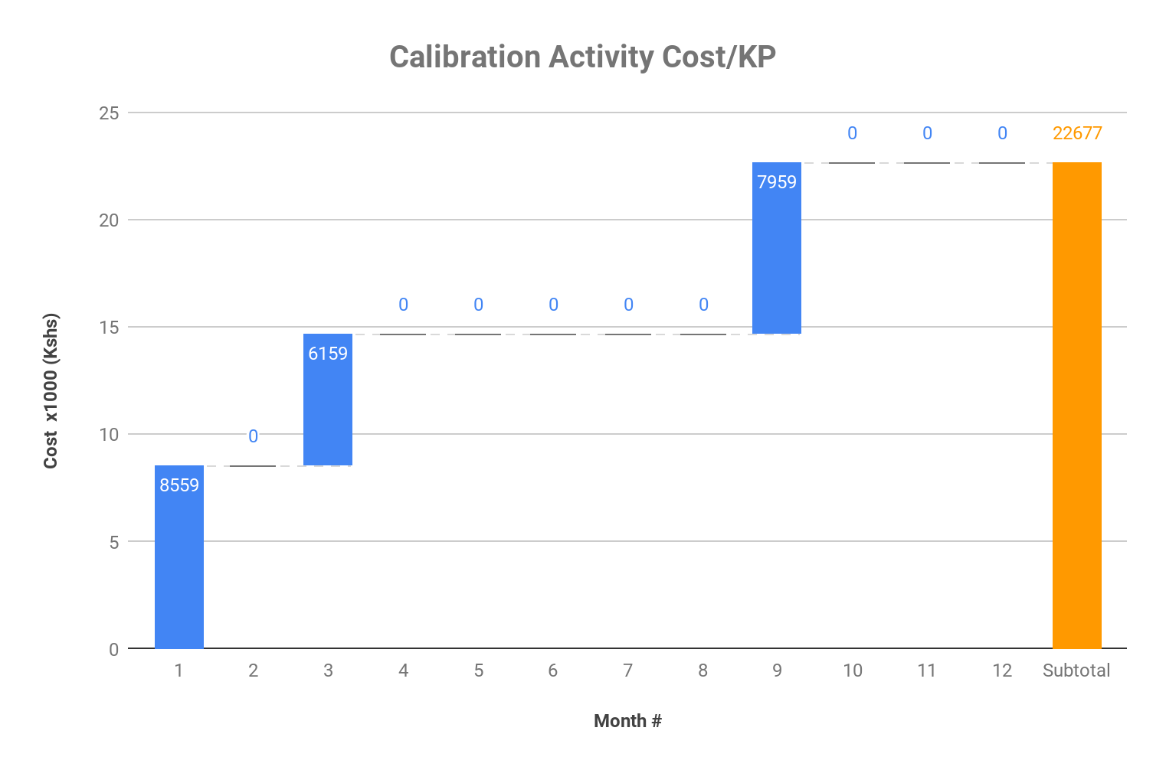
Costs
Item | Description | UoM | Unit Cost (Kshs)
Vehicle Lease | Vehicle and fuel cost | Month | 90000
Systems Group | Fixed cost per KP for each visit | KP | 1000
Weights & Measures | First time calibration | KP | 2400
 | 6 month verification | KP | 1800
Type 6 Technician | Hourly rate for a licensed technician | Hour | 1500
KNK Staff Cost | Month | Month | 2000
KNK+SG+W&M
KNK+SG
Notes
For a cost effective implementation solution, a gradual approach is highly recommended for retrofit of SMV and santoprene hoses as they directly affect calibration. Hence replacement should go along with ongoing KOKOpoint operational activities
Replacements to happen during
Maintenance activities when the SMV needs replacement
Calibration activities during either months 1, 3 or 9 when we have SG and W&M on location and only when there is a failure
Any new KOKOpoints being deployed
Estimated cost of the project (field roll out) stands at Kshs 6500000 split into 3 phases
KNK+SG+W&M

Slide 4
Implementation - Phase 1
Phase 1 of the project entails KOKOpoints due for the following activities
KOKOpoints yet to be sealed by W&M
New deployed KPs
Maintenance calibration incidents
Phase 1 field roll out estimated to take 4 weeks. The activities involved will be
Calibration
Break SG seal and W&M seal if available
Change the SMV and dispense tray and calibrate the KP
SG seals the KP and later W&M seals the KP
Other
Fit in the rubber grommet
Adjust the PVRV
Cost Breakdown
Item | Description | UoM | Unit Cost (Kshs) | Unit Cost/KP(Kshs)
Vehicle Lease | Vehicle and fuel cost | Month | 90000 | 1023
Systems Group | Fixed cost per KP for each visit | KP | 1000 | 1000
Weights & Measures | First time calibration | KP | 2400 | 2400
Type 6 Technician | Hourly rate for a licensed technician | Hour | 1500 | 3000
KNK Staff Cost | Month | Month | 160000 | 1818
Sub Total |  |  |  | 9241
Item | Qty | Cost (Kshs)
W&M Seal balance | 167 | 1543232
New KPs | 25 | 231023
Maintenance KPs | 10 | 92409
Total |  | 1866664

Slide 5
Implementation - Phase 2
Phase 2 of the project entails KOKOpoints due for the following activities
3 month due
New deployed KPs
Maintenance calibration incidents
Phase 2 field roll out estimated to take 4 weeks. The activities involved will be
Calibration
Break SG seal and W&M seal if available
Change the SMV and dispense tray and calibrate the KP
SG seals the KP and later W&M seals the KP
Other
Fit in the rubber grommet
Adjust the PVRV
Cost Breakdown
Item | Description | UoM | Unit Cost (Kshs) | Unit Cost/KP(Kshs)
Vehicle Lease | Vehicle and fuel cost | Month | 90000 | 1023
Systems Group | Fixed cost per KP for each visit | KP | 1000 | 1000
Weights & Measures | First time calibration | KP | 2400 | 2400
Type 6 Technician | Hourly rate for a licensed technician | Hour | 1500 | 3000
KNK Staff Cost | Month | Month | 160000 | 1818
Sub Total |  |  |  | 9241
Item | Qty | Cost (Kshs)
3 month verification | 205 | 1894386
New KPs | 25 | 231023
Maintenance KPs | 10 | 92409
Total |  | 2217818

Slide 6
Implementation - Phase 3
Phase 3 of the project entails KOKOpoints due for the following activities
6 month due
New deployed KPs
Maintenance calibration incidents
Phase 3 field roll out estimated to take 4 weeks. The activities involved will be
Calibration
Break SG seal and W&M seal if available
Change the SMV and dispense tray and calibrate the KP
SG seals the KP and later W&M seals the KP
Other
Fit in the rubber grommet
Adjust the PVRV
Cost Breakdown
Item | Description | UoM | Unit Cost (Kshs) | Unit Cost/KP(Kshs)
Vehicle Lease | Vehicle and fuel cost | Month | 90000 | 1023
Systems Group | Fixed cost per KP for each visit | KP | 1000 | 1000
Weights & Measures | First time calibration | KP | 2400 | 2400
Type 6 Technician | Hourly rate for a licensed technician | Hour | 1500 | 3000
KNK Staff Cost | Month | Month | 160000 | 1818
Sub Total |  |  |  | 9241
Item | Qty | Cost (Kshs)
6 month verification | 234 | 2162373
New KPs | 25 | 231023
Maintenance KPs | 10 | 92409
Total |  | 2485805

Slide 7


Resources/KOKOpoint
KOKO
Calibration Technician x1
Deployment Technician x1
Driver x1
Systems Group
Type 6 Technician x1
Weights & Measures
W&M Technician x1
Vehicles
Toyota Probox x3 or
Toyota Noah x 2 or
Van x1

Slide 8

Thank you

